Slide 1
MID ROAD HELPER
Under the guidance of
Dr. E. UMA Assistant Professor (SL.GR) Department of Information Science and Technology(DIST)
BALASANKAR S
2019202005
MCA(REGULAR)

Slide 2
MOTIVATION & OBJECTIVE
The main objective of MID ROAD HELPER is to get services easily when the user have an issue in their vehicle while travelling.
MID ROAD HELPER also helps helper services to get a business.
This project is made as user friendly as possible so that anyone can use it with little knowledge of system computers.
Only approved Helper Service are able to give service to user. To ensure the service is good

Slide 3
INTRODUCTION
This application is going to develop using HTML, CSS as frontend which helps to style a good user interface
PHP, MYSQL as backend which helps to get data form web page to the database and vice versa.
Visual Studio Code is used as a tool for coding HTML, CSS, and PHP. XAMPP server helps to run a MYSQL database.
Simple Mail Transfer Protocol (SMTP) is used for sending mail.
Google map API is used for location purposes with help of API key and geolocation, location of the user can be find and the same is used to list the helper service near the user area.
The most common attacks, SQL Injection and Cross Site Scripting (XSS) are prevented in this application

Slide 4
LITERATURE REVIEW
S.No. | Author name & Paper title | Concept in the paper (Algorithm, Advantages, Limitations, Future enhancement) | Paper details
1. | khoo jin sheng, ahmad suhaimi baharudin, kamal karkonasasi (2016). A car breakdown service station locator system | Car Breakdown Service Station Locator System has the advantage of returning the search result of CRSP nearby the user’s current location, with different CRSP is forming a network of assistance that functions anytime, anywhere. This enables the user to choose any of the CRSP of their own preference that is returned by the application without the constraint of only one CRSP. | https://www.researchgate.net/publication/311795116_A_Car_Breakdown_Service_Station_Locator_System
2. | V. Nithya, R.Regan , J.vijayaraghavan A Survey on SQL Injection attacks, their Detection and Prevention Techniques | The main consequences of these vulnerabilities are attacks on[36]: i) Authorization: Critical data that are stored in a vulnerable SQL database may be altered by a successful SQLIA, a authorization privilege. ii) Authentication: If there is no any proper control on username and password inside the authentication page , it may be possible to login to a system as a normal user without knowing the right username and/or password. iii) Confidentially: Usually databases are consisting of sensitive data such as personal information, credit card numbers and/ or social numbers. Therefore loss of confidentially is a big problem with SQL Injection vulnerability. Actually, theft of sensitive data is one of the most common intentions of attackers. iv) Integrity: By a successful SQLIA not only an attacker reads sensitive information, but also, it is possible to change or delete this private information. | https://www.ijcsmc.com/docs/papers/August2017/V6I8201701.pdf

Slide 5


IMPLEMENTATION PLATFORM / FRAMEWORK
XAMPP
VS CODE

Slide 6
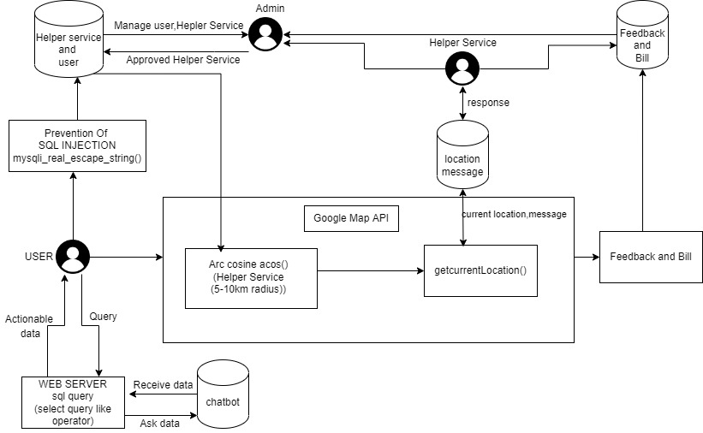
OVERALL ARCHITECTURE (with completed modules highlighted)

Slide 7
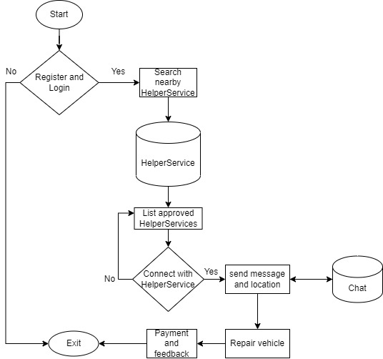
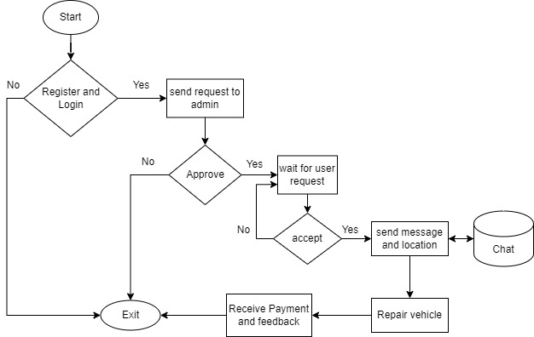
Detailed design of each module with flow chart
USER
HELPER SERVICE

Slide 8
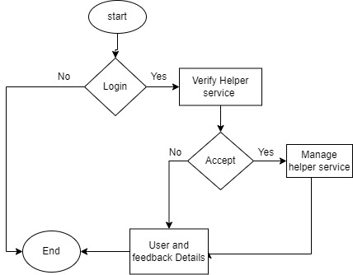
Detailed design of each module with flow chart
Admin

Slide 9
EXAMPLE: ALGORITHM STEPS
Start
Problem: To get nearest location
Algorithm:
Step 1: Start
Step 2: Read lat , lon
Step 3:distance<-(((acos(sin(( $lat * pi() / 180))*sin(( latitude * pi() / 180)) +
cos(( $lat * pi() /180 ))*cos(( latitude * pi() / 180)) *
cos((( $lng - longitude) * pi()/180)))) *
180/pi()) * 60 * 1.1515 * 1.609344)
Step4:if(distance<=15) then
print location
Step-5:Stop
Read lat , lon
distance<-(((acos(sin(( $lat * pi() / 180))*sin((latitude * pi() / 180)) +cos(( $lat * pi() /180 ))*cos(( latitude * pi() / 180)) *cos((( $lng - longitude) * pi()/180)))) * 180/pi()) * 60 * 1.1515 *1.609344)
if(distance<=15)
print location
YES
NO
Stop

Slide 10
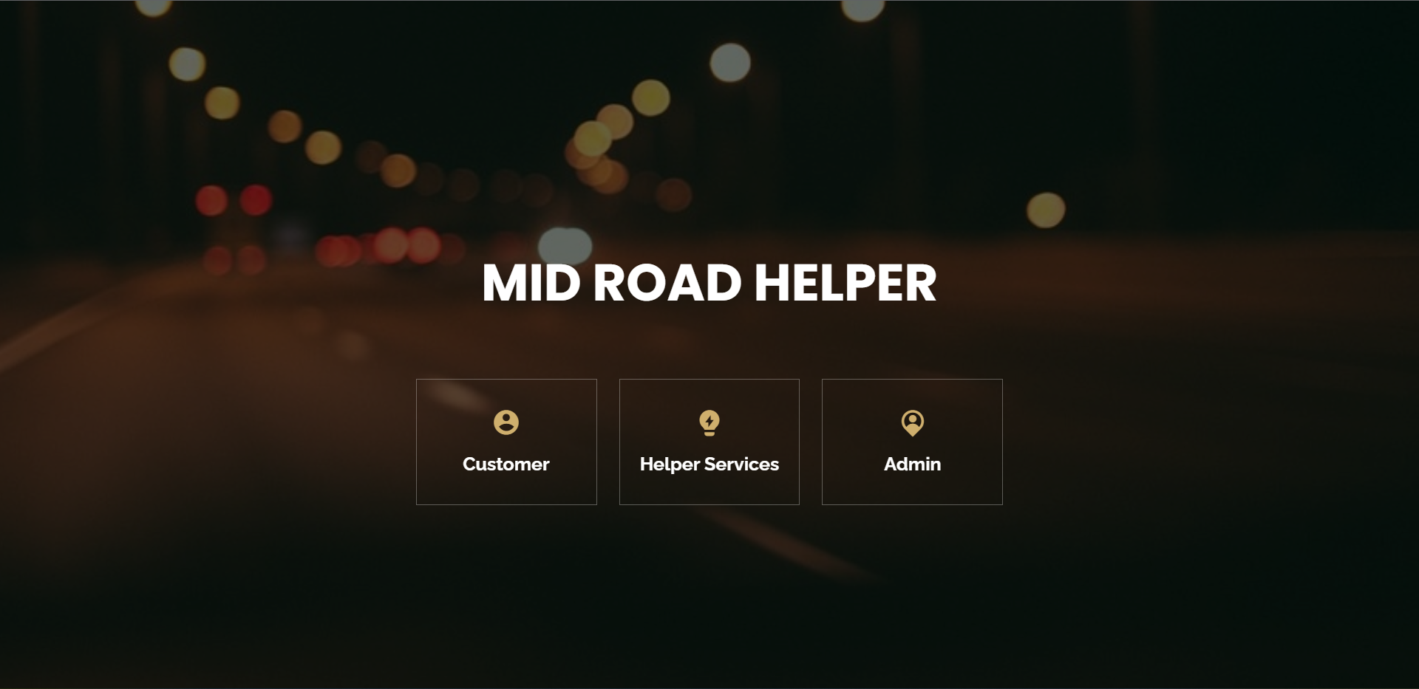
MODULE BASED OUTPUT SCREENSHOTS
Home Page

Slide 11
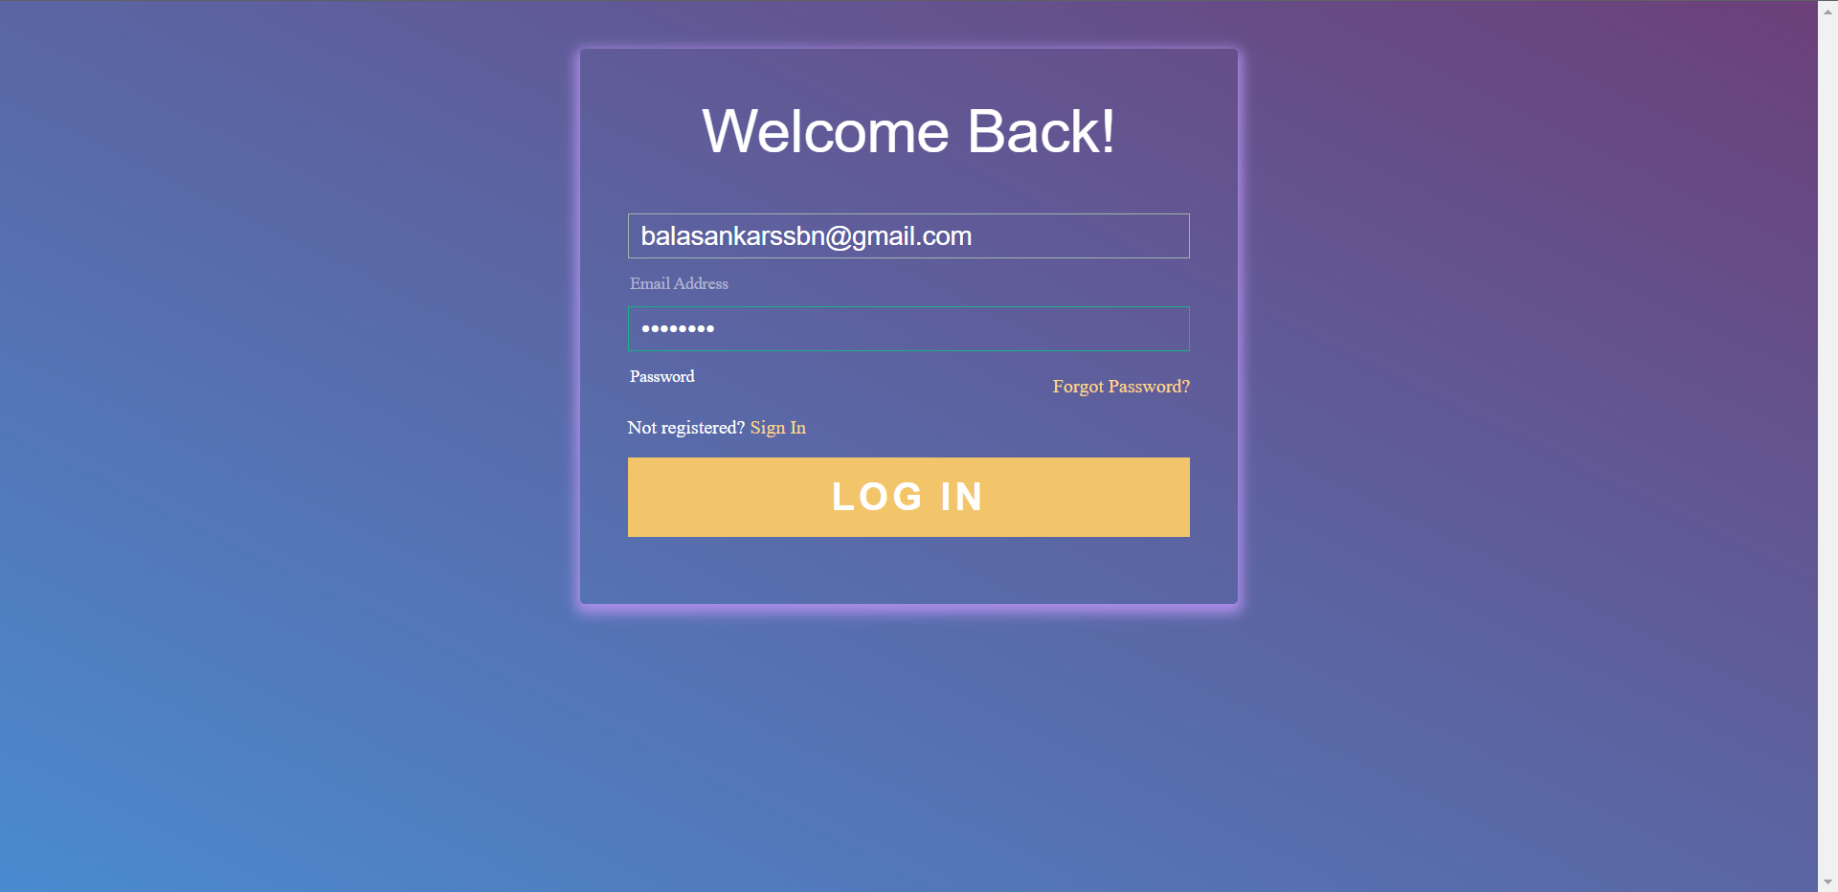
MODULE BASED OUTPUT SCREENSHOTS
Login Page

Slide 12
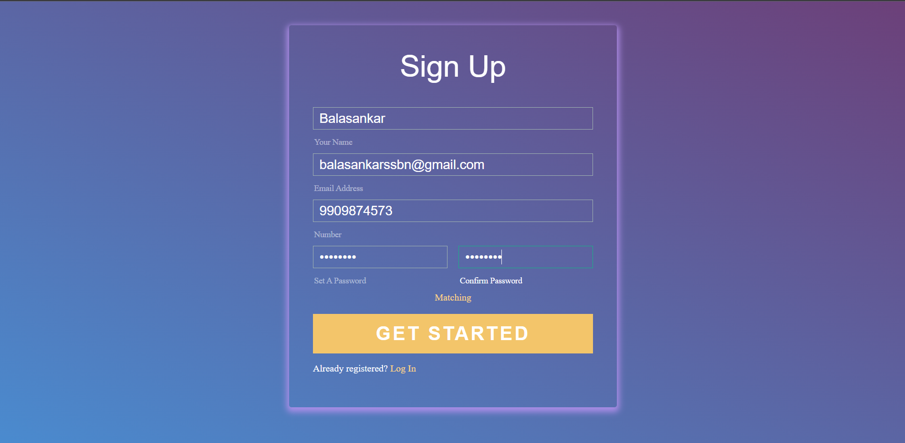
MODULE BASED OUTPUT SCREENSHOTS
User Registration

Slide 13
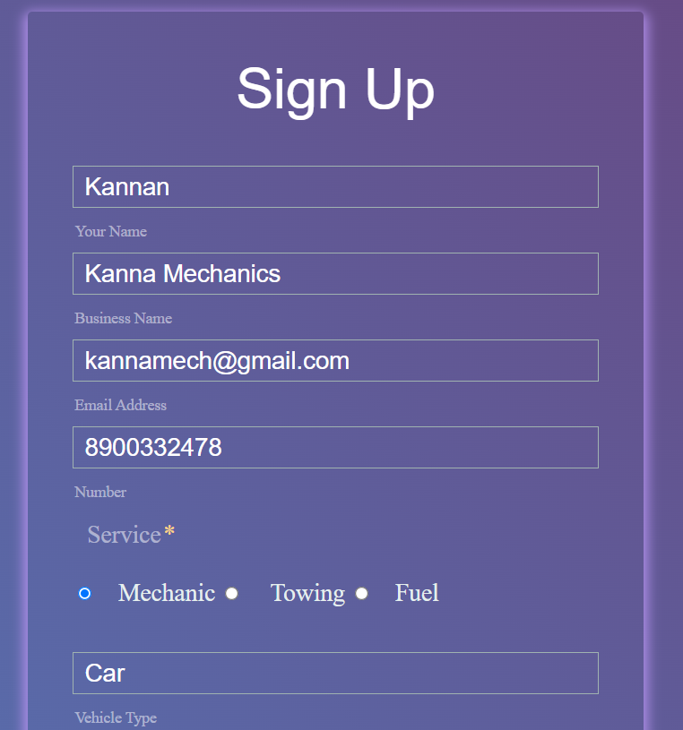
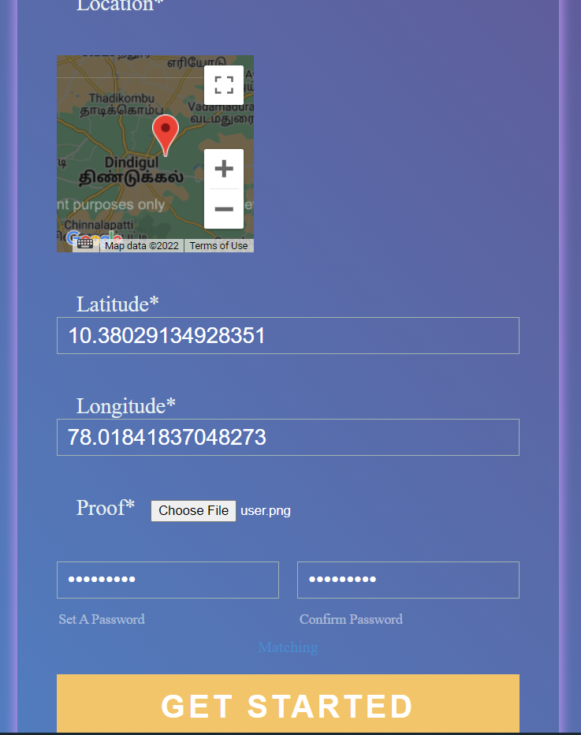
MODULE BASED OUTPUT SCREENSHOTS
Helper Service Registration

Slide 14
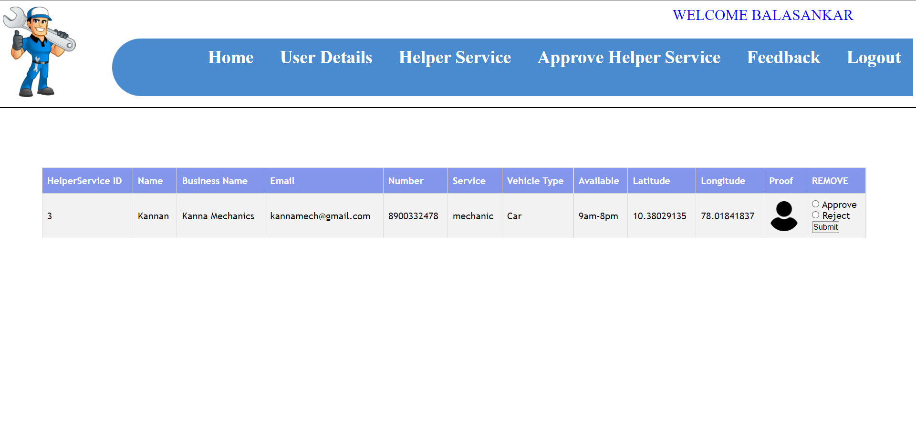
MODULE BASED OUTPUT SCREENSHOTS
Admin Approve Helper Service page

Slide 15
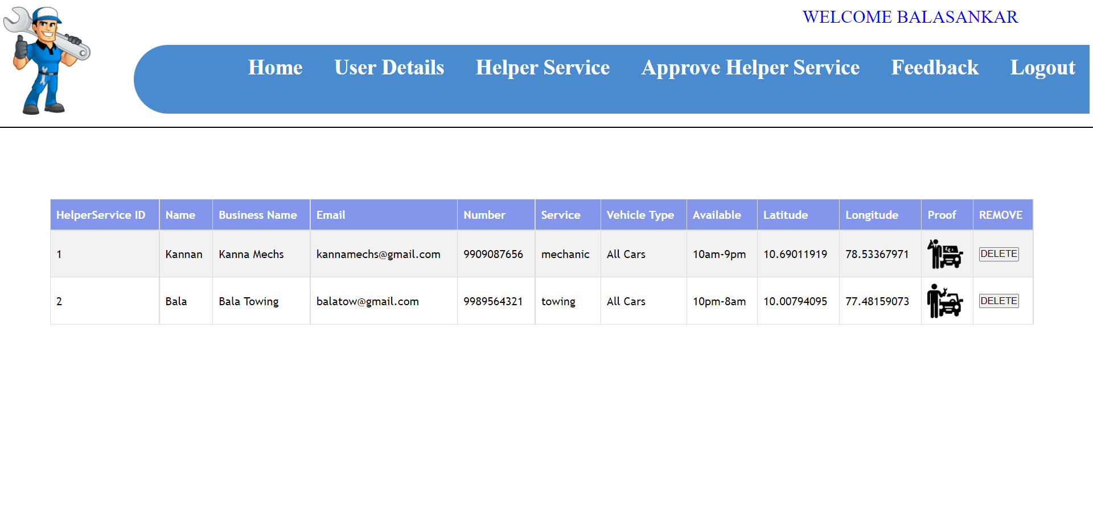
MODULE BASED OUTPUT SCREENSHOTS
Admin Manage Helper Service Page

Slide 16
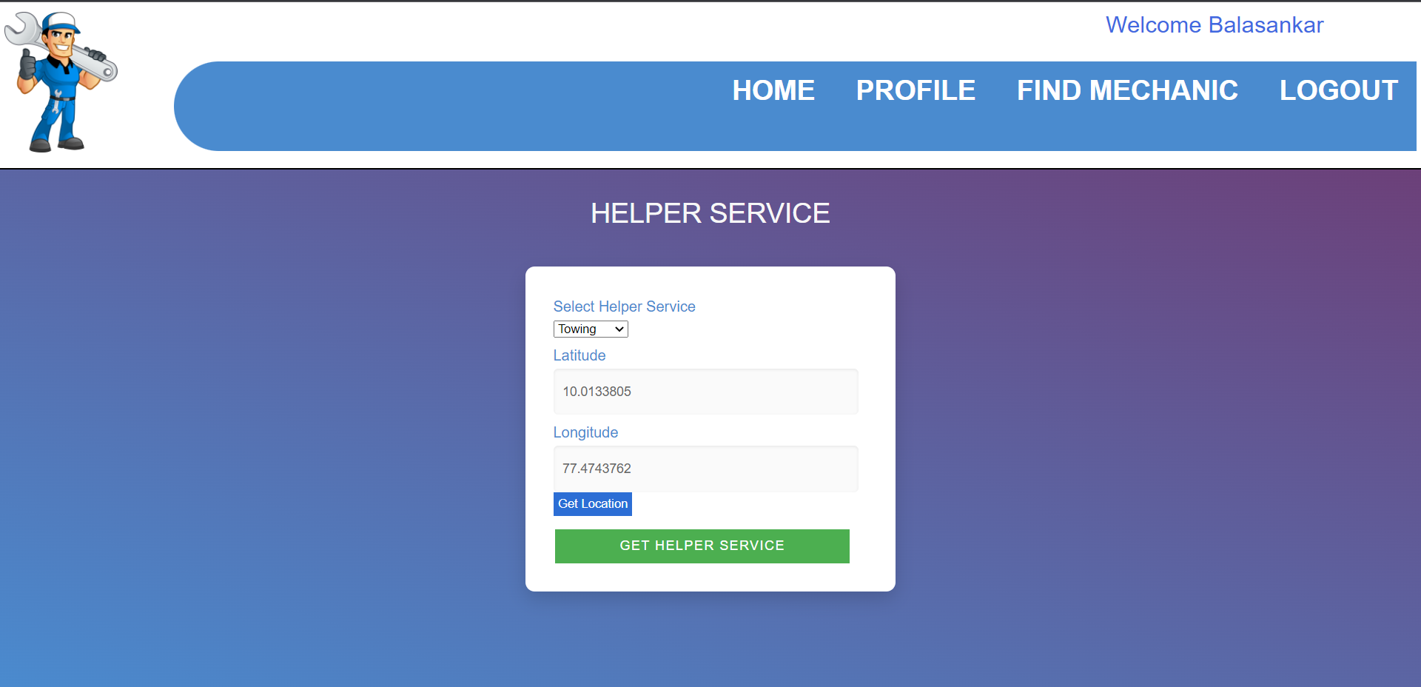
MODULE BASED OUTPUT SCREENSHOTS
Find Mechanic

Slide 17
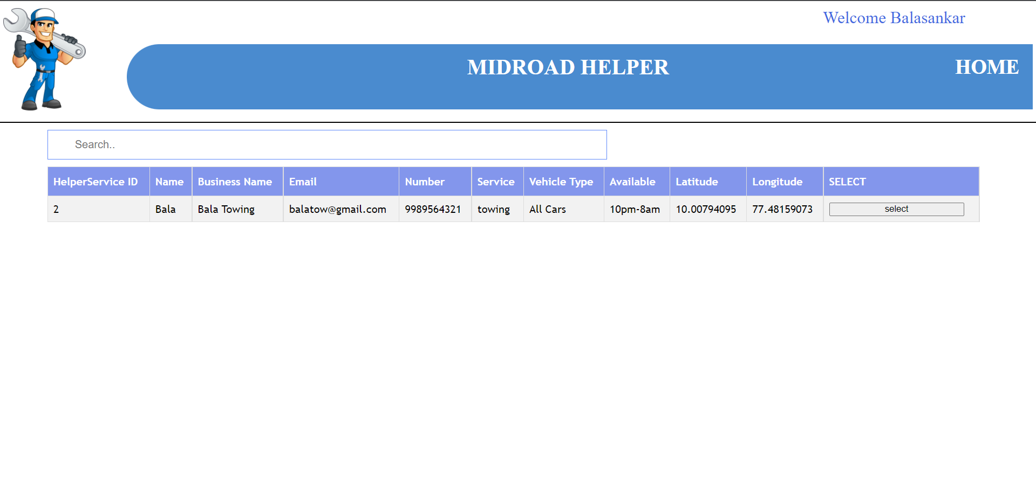
MODULE BASED OUTPUT SCREENSHOTS
Connect with Mechanic

Slide 18
REFERENCES
PHP documentation Available from:
https://php-legacy-docs.zend.com/manual/php4/en/index
Mail Transfer Using PHP Documentation Available from:
https://www.php.net/manual/en/function.mail.php
Google Maps API Tutorial Available from:
https://developers.google.com/maps/documentation/javascript/overview
Database Connection Documentation Available from:
https://www.javatpoint.com/creating-mysql-database-with-xampp

Slide 19
THANK YOU

